Slide 1

Elementary Statistics
Thirteenth Edition
Chapter 8
Hypothesis Testing
Copyright © 2018, 2014, 2012 Pearson Education, Inc. All Rights Reserved

Slide 2
Hypothesis Testing
8-1 Basics of Hypothesis Testing
8-2 Testing a Claim about a Proportion
8-3 Testing a Claim About a Mean
8-4 Testing a Claim About a Standard Deviation or Variance

Slide 3
Key Concept
This section presents methods for conducting a formal hypothesis test of a claim made about a population standard deviation σ or population variance σ². The methods of this section use the chi-square distribution.

Slide 4
Testing Claims about σ or σ²: Objective
Objective
Conduct a hypothesis test of a claim made about a population standard deviation σ or population variance σ².

Slide 5
Testing Claims about σ or σ²: Notation
Notation
n = sample size
s = sample standard deviation
σ = population standard deviation
s² = sample variance
σ² = population variance

Slide 6
Testing Claims about σ or σ²: Requirements
Requirements
The sample is a simple random sample.
The population has a normal distribution. (This is a fairly strict requirement.)

Slide 7

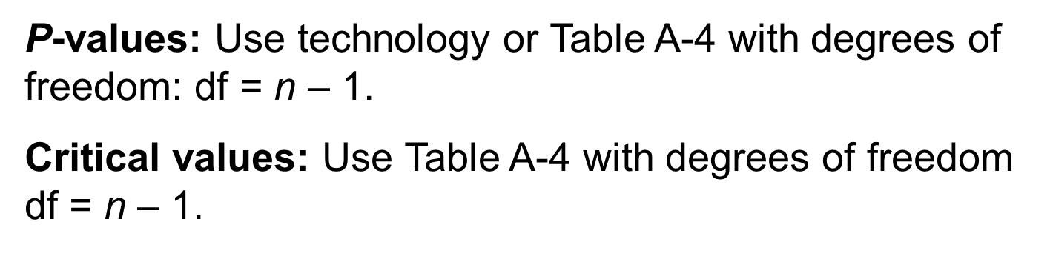
Testing Claims about σ or σ²: Test Statistic
Test Statistic
P-values: Use technology or Table A-4 with degrees of freedom: df = n $\text{–}$ 1.
Critical values: Use Table A-4 with degrees of freedom df = n $\text{–}$ 1.

Slide 8
Equivalent Methods
When testing claims about σ or σ², the P-value method, the critical value method, and the confidence interval method are all equivalent in the sense that they will always lead to the same conclusion.

Slide 9
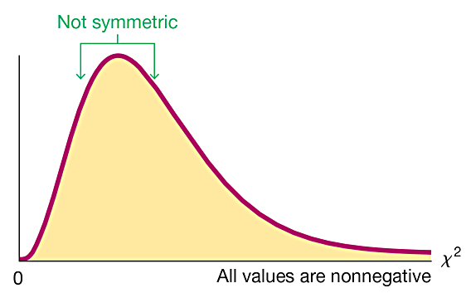
Properties of the Chi-Square Distribution (1 of 3)
All values of χ² are nonnegative, and the distribution is not symmetric.

Slide 10
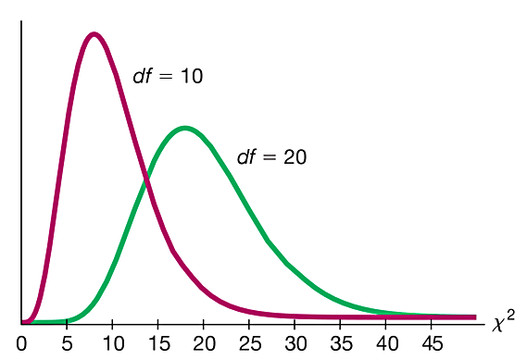
Properties of the Chi-Square Distribution (2 of 3)
There is a different χ² distribution for each number of degrees of freedom.

Slide 11
Properties of the Chi-Square Distribution (3 of 3)
The critical values are found in Table A-4 using degrees of freedom = n – 1
An important note if using Table A-4 for finding critical values:
In Table A-4, each critical value of χ² in the body of the table corresponds to an area given in the top row of the table, and each area in that top row is a cumulative area to the right of the critical value.

Slide 12
Example: P-Value Method: Do Super Model Heights Vary Less? (1 of 7)
Listed below are the heights (cm) for the simple random sample of female supermodels. Use a 0.01 significance level to test the claim that supermodels have heights with a standard deviation that is less than σ = 7.5 cm for the population of women. Does it appear that heights of supermodels vary less than heights of women from the population?
178 177 176 174 175 178 175 178 178
177 180 176 180 178 180 176

Slide 13
Example: P-Value Method: Do Super Model Heights Vary Less? (2 of 7)
Solution
Requirement Check (1) The sample is a simple random sample.

Slide 14
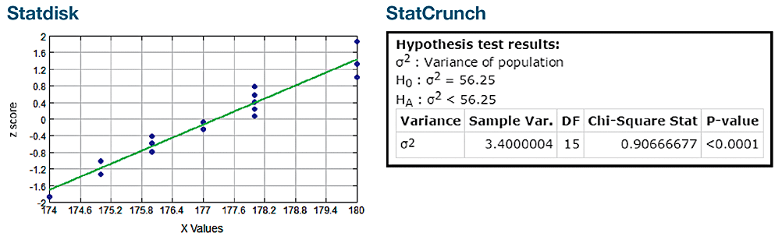
Example: P-Value Method: Do Super Model Heights Vary Less? (3 of 7)
Solution
Requirement Check (2) In checking for normality, we see that the sample has no outliers, the normal quantile plot shows points that are reasonably close to a straight-line pattern, and there is no other pattern that is not a straight line.

Slide 15
Example: P-Value Method: Do Super Model Heights Vary Less? (4 of 7)
Solution
Technology capable of conducting this test will typically display the P-value. StatCrunch can be used as described at the end of this section, and the result will be as shown in the figure. (Instead of using the assumed value of σ for H₀ and H₁, StatCrunch uses σ². For the null hypothesis, σ = 7.5 is equivalent to σ² = 7.52² = 56.25.)
The display shows that the test statistic is χ² = 0.907 (rounded) and the P-value is less than 0.0001.

Slide 16
Example: P-Value Method: Do Super Model Heights Vary Less? (5 of 7)
Solution
Step 1: The claim “the standard deviation is less than 7.5 cm” is expressed as σ < 7.5 cm.
Step 2: If the original claim is false, then σ ≥ 7.5 cm.
Step 3: The expression σ < 7.5 cm does not contain equality, so it becomes the alternative hypothesis. The null hypothesis is the statement that σ = 7.5 cm.
H₀: σ = 7.5 cm
H₁: σ < 7.5 cm (original claim)

Slide 17
Example: P-Value Method: Do Super Model Heights Vary Less? (6 of 7)
Solution
Step 4: The significance level is α = 0.01.
Step 5: Because the claim is made about σ, we use the χ² (chi-square) distribution.
Step 6: The StatCrunch display shows the test statistic of χ² = 0.907 and it shows that the P-value is less than 0.0001.

Slide 18
Example: P-Value Method: Do Super Model Heights Vary Less? (7 of 7)
Solution
Step 7: Because the P-value is less than the significance level of α = 0.01, we reject H₀.
Interpretation
Step 8: There is sufficient evidence to support the claim that female supermodels have heights with a standard deviation that is less than 7.5 cm for the population of women. It appears that heights of supermodels do vary less than heights of women in the general population.

Slide 19

Critical Value Method (1 of 2)
Steps 1 through 5 in the previous example would be the same. In Step 6, the test statistic is calculated by using σ = 7.5 cm (as assumed in the null hypothesis), n = 16, and s = 1.843909 cm, which is the unrounded standard deviation computed from the original list of 16 heights. We get this test statistic:

Slide 20
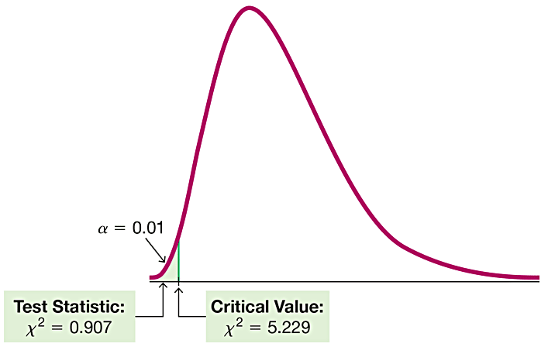
Critical Value Method (2 of 2)
The critical value of χ² = 5.229 is found from Table A-4, and it corresponds to 15 degrees of freedom and an “area to the right” of 0.99 (based on the significance level of 0.01 for a left-tailed test).

Slide 21
Example: Super Model Heights: Critical Value Method (1 of 4)
In Step 7 we reject the null hypothesis because the test statistic of χ² = 0.907 falls in the critical region.
We conclude that there is sufficient evidence to support the claim that supermodels have heights with a standard deviation that is less than 7.5 cm for the population of women.

Slide 22
Example: Super Model Heights: Critical Value Method (2 of 4)
Solution
First, we should be careful to select the correct confidence level. Because the hypothesis test is left-tailed and the significance level is 0.01, we should use a confidence level of 98%, or 0.98.

Slide 23
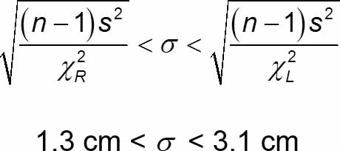
Example: Super Model Heights: Critical Value Method (3 of 4)
Solution
We can use the sample data listed in the example to construct a 98% confidence interval estimate of σ. We use n = 16, s = 1.843909 cm, χ²_{L} = 5.229, and χ²_{R} = 30.578.

Slide 24
Example: Super Model Heights: Critical Value Method (4 of 4)
Solution
With this confidence interval, we can support the claim that σ < 7.5 cm because all values of the confidence interval are less than 7.5 cm.

